Slide 1
Software Testing and Quality Assurance
Lecture – 26

Slide 2
Agenda
Wrap-up
Conclusion
Structural Testing
Unit Testing
From Unit to Integration Testing
OO Protocol Testing
Finite State Machines for Testing

Slide 3
Unit Testing (Wrap up)
While developing unit test strategy, we consider:
Test Requirement
Documentation requirement
Tools / Test utilities?
Determine extent of unit testing (i.e., in
advance).
do not just “test until time expires”
prioritize, so that important tests definitely performed
Decide how and where to get the test input
Estimate the resources required
use historical data if available
Arrange to track time, defect count, type & source

Slide 4
Unit Test Cases Guidelines
Considering our black-box testing knowledge, we write test cases to test operations considering:
normal parameter values
limit parameter values
outside parameter values
(black box)
Considering our white-box testing knowledge, we write test cases to test operations ensuring:
all instructions execute (statement coverage)
all paths, including both sides of all branches execute(decision coverage)
use of all called objects
handling of all data structures
handling of all files

Slide 5
OO Protocol
Procedural software
unit = single program, function, or procedure
Object oriented software
unit = class
unit testing = intra-class testing
integration testing = inter-class testing (cluster of classes)
dealing with single methods separately is usually
too expensive (complex scaffolding)
Therefore, methods are usually tested in the context of the class they belong to

Slide 6
Class in terms of State-Machine
Natural representation with finite state Machines
States correspond to certain values of the Attributes
Transitions correspond to methods
FSM can be used as basis for testing
e.g. “drive” the class through all transitions, and verify the response and the resulting state
Test cases are sequences of method calls that traverse the state machine
State machine model can be derived from:
Specification
Code
also using reverse engineering techniques
or both …

Slide 7
Assume we had code…
public class stack
{
public final intmax = 10; public Boolean isFull { … } public add{ … }
public delete { … } public destroy { … } public { … }
public create{ … }
}

Slide 8
Extracting States and transitions
States:
Initial: before creation
Empty: number of elements = 0
Holding: number of elements >0, but less than
the max Capacity
Full: number elements = max
Final: after destruction
Transitions:
create, destroy
actions that triggers the transition
ex. Add, delete

Slide 9
Arranging transitions
Initial -> Empty: action = “create”
e.g. “s = new Stack()” in Java
Empty -> Holding: action = “add”
Empty -> Full: action = “add”
if MAXcapacity=1
Empty -> Final: action = “destroy”
e.g. destructor call in C++, garbage collection in Java
Holding -> Empty: action = “delete”
if s.size() = 1

Slide 10
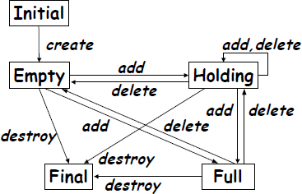
State machine – stack

Slide 11
State based testing
The tests are derived from a state model of the system. We can derive the state model in several way, e.g. from
Expected system behavior
State part of a UML design or requirements specification.
Other state diagrams
Most system will, however, have a large number of
states

Slide 12
Fault types
Missing or incorrect
Transitions – new state is legal but incorrect
Events – valid message ignored
Extra, missing or corrupt state
Sneak path
Illegal message failure
Trap door

Slide 13
Coverage Criteria
We can choose one or more of the following test selection criteria:
All states – testing passes through all states
All events – testing forces all events to occur at least once
All actions – testing forces all actions to be produced at least once

Slide 14
Test Strategies
Possible strategies
All round-trip paths
All transition sequences beginning and ending in the same state
All simple paths from initial to final state
This strategy will help you to find
All invalid or missing states
Some extra states
All event an action faults

Slide 15
Question?
What if
we have concept level documents to consider
Could be
UML documents
Specifications
etc.
Account
status: enum balanace: int
isActive(): boolean isBlocked(): boolean isClosed(): boolean gotBalance(): int block() unblock() close() deposit(amount: int) withdraw(amount: int)

Slide 16
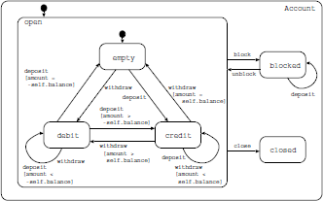
Answer!
We develop state-machines considering these artifacts…
But how…
Account
status: enum balanace: int
isActive(): boolean isBlocked(): boolean isClosed(): boolean gotBalance(): int block() unblock() close() deposit(amount: int) withdraw(amount: int)

